Slide 1
OBJECTS IN JAVASCRIPT
Sai Vardhan T

Slide 2
OBJECTS IN JS
In JavaScript, objects are collections of key-value pairs.
They are one of the fundamental data types in the language and are widely used for storing and organizing data.
Here's how you can create and work with object key-value pairs in JavaScript:
Creating objects
Accessing Objects
Adding
Deleting
Methods

Slide 3
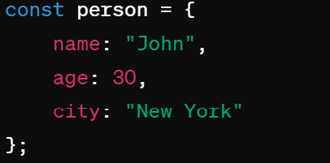
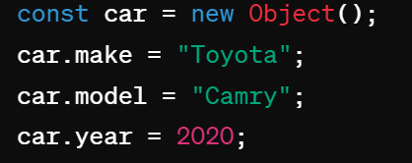
CREATING OBJECTS
Method –1
Method – 2

Slide 4
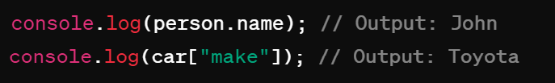
ACCESSING VALUES
Syntax:
Objectname.value

Slide 5

ADDING / MODIFYING
Adding / Modification
Syntax:
Objectname[attribute]= value;
Adding / Modification
Syntax:
Objectname.attribute = value;

Slide 6

DELETING PROPERTIES
DELETING ATTRIBUTE
Syntax:
Delete Objectname[attribute];
DELETING ATTRIBUTE
Syntax:
Delete Objectname.attribute;

Slide 7
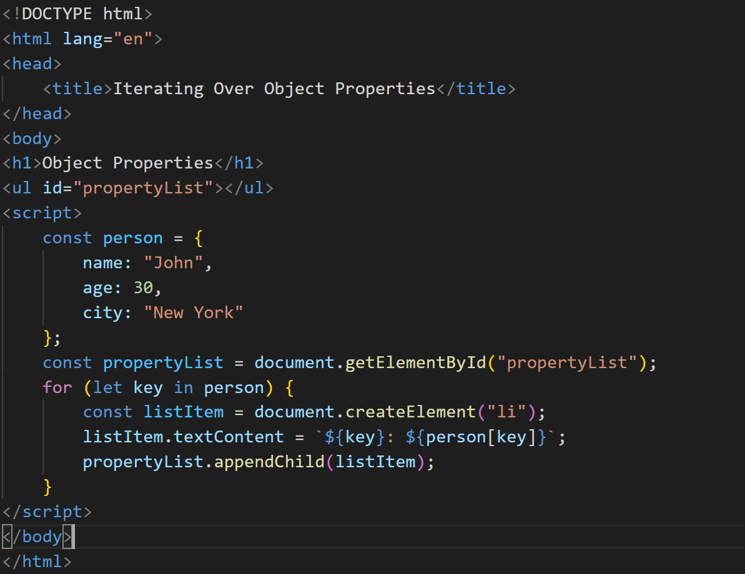
ITERATING OVER OBJECT PROPERTIES

Slide 8
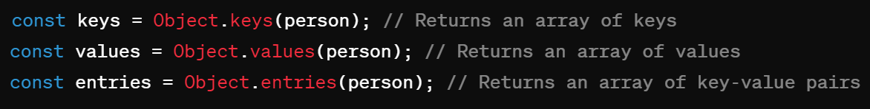
OTHER METHODS
JavaScript objects also have built-in methods for various operations.
Some common ones include Object.keys(), Object.values(), and Object.entries().

